Slide 1
INTRODUCTION
The 555 timer is a popular integrated circuit (IC) used in a wide range of electronic circuits, such as oscillators, timers, and flip-flops.
It was first introduced by Signetics Corporation in 1971, and since then, it has become one of the most widely used ICs in the world.
The 555 timer has three operational modes: monostable, astable, and bistable.
The 555 timer is a versatile IC that is easy to use and can be operated from a wide range of voltage supplies, making it suitable for a wide range of applications.
It is widely available and is one of the most cost-effective ICs available in the market.

Slide 2
COMPONENTS REQUIRED:-
555 IC
8 Ohm Speaker
Momentary Push Button Switches x 8
Capacitors: 100nF, 10uF
Resistors: 7 x 1K, 4.7K
Breadboard
Few Breadboard Connectors
9V of Power Supply

Slide 3
HOW THIS CIRCUIT WORKS
Changing the value of resistor in series with the capacitor changes the Frequency. And the relation is of inverse proportionality i.e, if the value of resistance in series to the capacitor is large, the frequency will be less, and vice versa.
Formula for calculating the frequency of the output sound/tone:
Frequency (f) = 1.44 / ( (R1 + 2 * R2) x C1 )
In the circuit we made, the value of R1 is 1K and C1 is 100n. After replacing these values in the above formula, we have:
Frequency (f) = 1.44 / ( (1000 + 2 * R2) x 10-7 )
We can also rearrange the formula to calculate the value of resistor we need to use for any frequency required:
Resistance (R2) = ( ( 1.44 x 107 ) / f ) - 500

Slide 4
MUSICAL NOTES & FREQUENCIES
Switch Resistance Frequency Musical Notes
Switch 1 7k+4.7k 1109 Hz C#
Switch 2 6k+4.7k 1175 Hz D
Switch 3 5k+4.7k 1319 Hz E
Switch 4 4k+4.7k 1397 Hz F
Switch 5 3k+4.7k 1568 Hz G
Switch 6 2k+4.7k 1800 Hz A
Switch 7 1k+4.7k 2093 Hz C
Switch 8 4.7k 2489 Hz D#

Slide 5
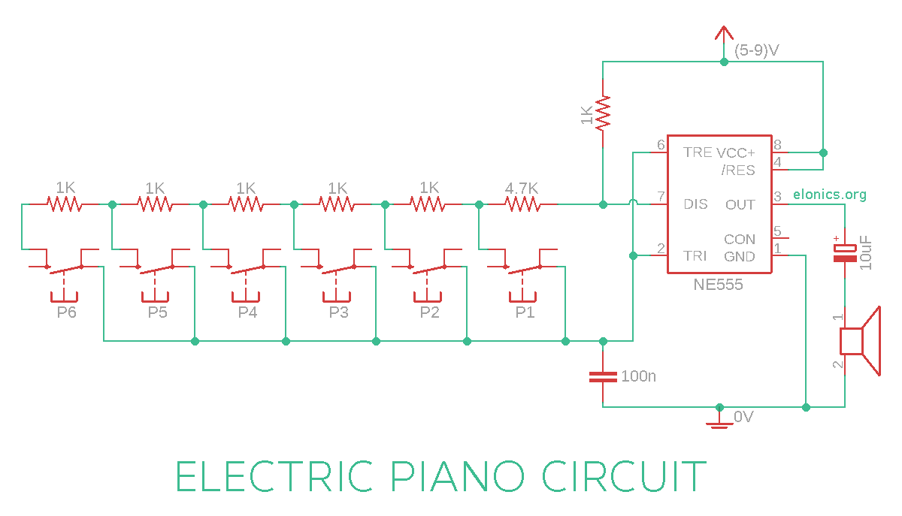
DIAGRAM

Slide 6
PRINCIPLE
Piano is developed by connecting a 555 timer ASTABLE multivibrator with variable frequency to a speaker. Piano is a wonderful musical instrument and one can make a cheap one using 555 timer IC chip. This concept of piano is achieved by making the timer generate 5-15 different kind of sounds.

Slide 7
FUTURE SCOPE:-
Touch Switch: You can use a touch sensor to trigger a 555 timer circuit, which can be used to switch an LED or a relay on or off.
Touch-controlled Oscillator: You can use a touch sensor to control the frequency of a 555 timer oscillator circuit.
Touch-controlled Tone Generator: You can use a touch sensor to control the frequency of a 555 timer tone generator circuit.
Touch-controlled Light Dimmer: You can use a touch sensor to control the brightness of an LED or a lamp using a 555 timer circuit.
Touch-controlled Timer: You can use a touch sensor to trigger a 555 timer circuit, which can be used as a timer.

Slide 8
THANK YOU

